Slide 1
CAPSTONE II AIDI-2005-02 MARCOS BITTENCOURT JEFFREY ARUNASALAM - 100783993 ADITYA PATEL – 100800011 ADEL SALEM – 100772208 2021/02/01
AUTOMATIC ATTENDANCE SYSTEM

Slide 2
LAYOUT
TEAM NAME: FACIAL RECOGNITION FOR ATTENDANCE
PRODUCT NAME: SMART ATTENDANCE
TECH LEAD: JEFFREY ARUNASALAM
TEAM MEMBERS: ADEL SALEM, ADITYA PATEL, JEFFREY ARUNASALAM
EMAILS: aditya.patel3@dcmail.ca , jeffrey.arunasalam@dcmail.ca, Adel.Baabbad@dcmail.ca

Slide 3
Executive Summary:
When a student enters a classroom; they enter their face to a camera (which scans their face) and marks whether they are present or not. Its would also be recommended that in conjunction of scanning the face, the student also has their identification card with that is also scanned to confirm they are present. The images taken would be stored for manual review if in the future its been deemed that an error has been done or a student has attempted to bypass the system through fraudulent means.
Out of scope (limitations) of the project is: [TO BE NEGOTIATED BY TEAM]
-CAMERA WILL NOT BE DETECTING FROM A FAR RANGE (to ensure accuracy)
-NOT A SOFTWARE TO MONITOR DURING EXAMINATION (ex. Anti-Cheat software that detects unusual eye, head movement during tests)

Slide 4
Rationale Statement:
In schools and colleges, a lot of time is wasted in taking the attendance of the students. The idea of the project is to automate the attendance system by using a camera that automatically recognizes the faces and marks the attendance of the people.

Slide 5
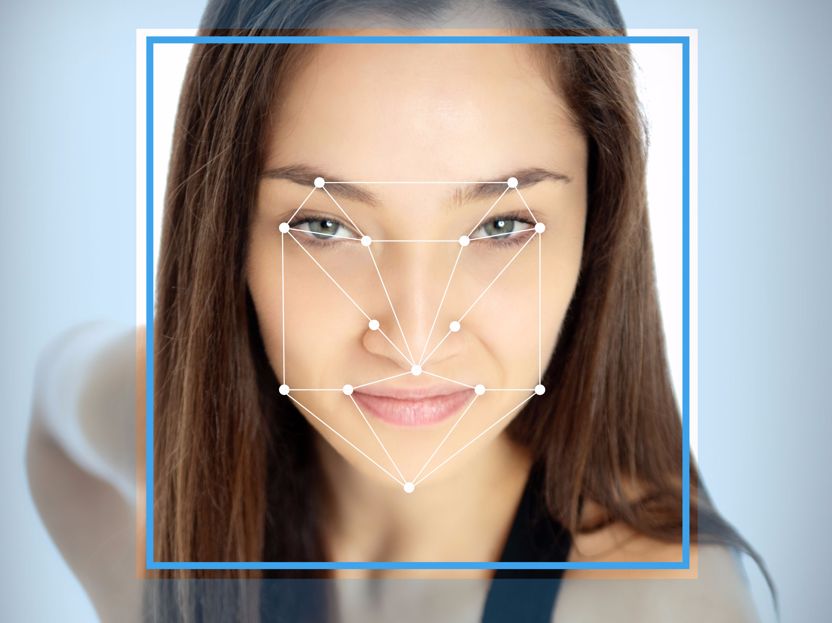
Preliminary Data manipulations Requirements:
The Face Image Format Standards (nist.gov)
Images being converted to NumPy arrays and stored in a text file can make it easier to store data (without costing too much storage).
Pillow, CV2, TensorFlow and other options are being
explored.
Features (variables of human face) such as eyes, eye brows, Nose, mouth, Jawline will be used to determine

Slide 6
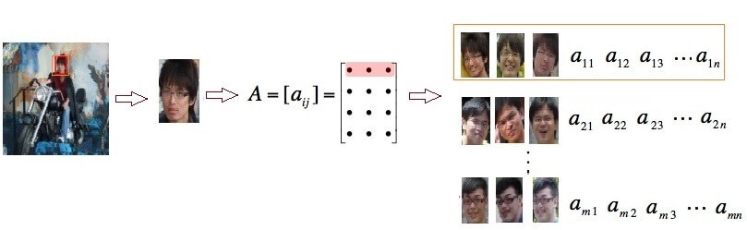
Model/Architecture Approach:(example)
Facial Recognition System - How it Works, Architecture & Applications (electricalfundablog.com)
Model Priority be on the application, user interface will be secondary once the core software functions are in place and are reliable to operate.

Slide 7
HOW IT WILL BE USED (PROJECT PRESENTATION)
User would have their face scanned and would be matched with existing photos (comparing new image to student photo ID)
The system will have to be able to identify whether a photo of a student is being presented or it is a student in real time (identify false positives).
Store the data for manual review and expand the database.
LEGEND (system response to user[WIP]):
RED FLASH – Student Recognized (not in database or screen capturing of image was blurry to determine any outcome)
GREEN FLASH – Student Recognized (Present)
ORANGE FLASH – Blurry/Error bound (ex. camera out of service, malfunction detected)
**WHITE FLASH/RED FLASH (dual) – Detection of user using a photo/video (not real time) to trick camera into determining that person is present.

Slide 8
References
The Face Image Format Standards (nist.gov)
Facial Recognition System - How it Works, Architecture & Applications (electricalfundablog.com)
https://azure.microsoft.com/en-ca/services/cognitive-services/face/

